Slide 1

Stock Market prediction project
Technical presentation
Choosing which Stock to trade
Predicting with Linear Regression
Prediction with LSTM

Slide 2





Stocks in review

Slide 3
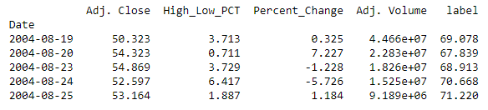
Analyse the stock data
Fetch Stock Data via Quandl
Create Calculated Columns - High - Low % , Percentage Change
Create Label Column for Forecast

Slide 4
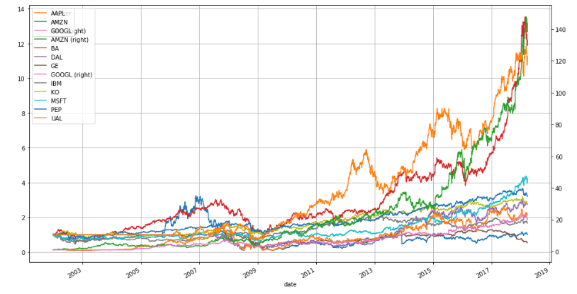
Calculating simple daily cumulative returns - Plot
Notes:
Calculating simple daily percentage change
Calculating simple daily cumulative returns
Analyzing the distribution of returns

Slide 5
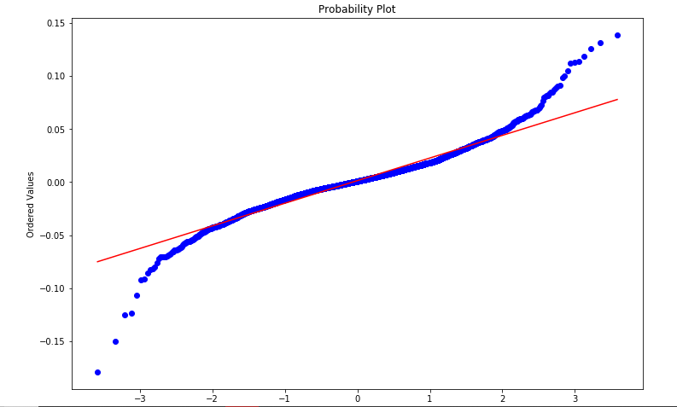
QQ Plot
Q-Q plot of the returns of a stock compared to a normal distribution to get a feel of how close our returns are to a normal distribution
Between quantiles -2 and +2, most of our data is very close to being perfectly correlated.
Notes:
Calculating simple daily percentage change
Calculating simple daily cumulative returns
Analyzing the distribution of returns

Slide 6
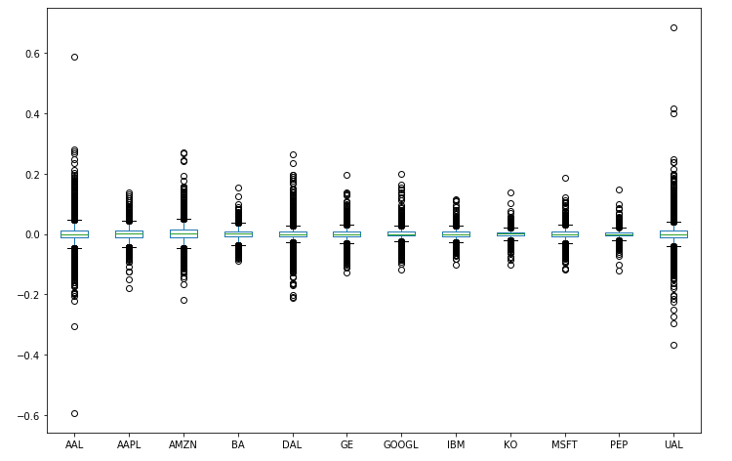
Box plot – stock comparison
This plot gives us a very good comparison of the performance of these stocks over this period of time.
The wider the box, the higher the variability and the risk.
Notes:
Calculating simple daily percentage change
Calculating simple daily cumulative returns
Analyzing the distribution of returns

Slide 7
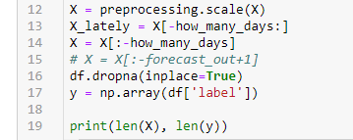
Linear Regression Stock Prices - Google Prediction
Data Preprocessing
The pre-processing.scale() algorithm puts your data on one scale
scaling the data brings all your values onto one scale eliminating the sparsity

Slide 8
Train - test
Split data for Train and Test

Slide 9
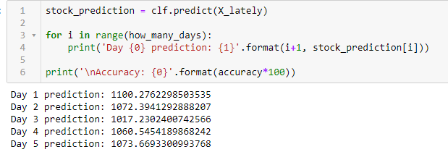
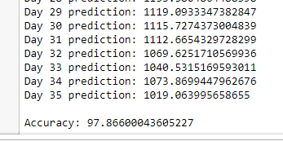
Create a Prediction
Predict the next period prices
Stock Predictor Accuracy of 97.86%

Slide 10
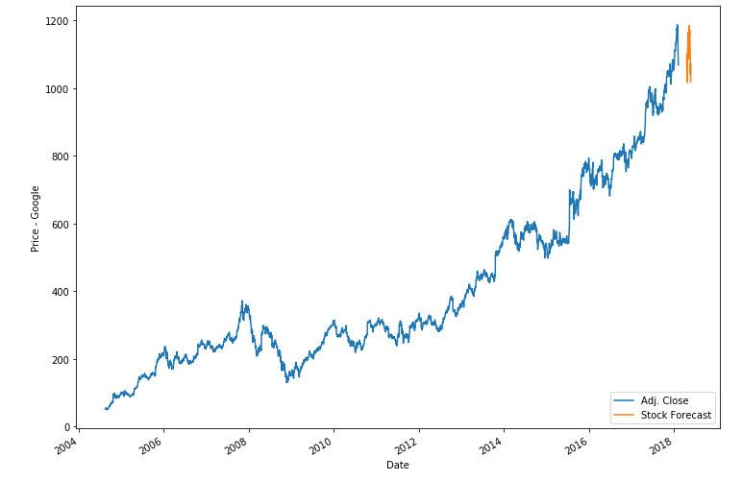
Prediction plot Google

Slide 11
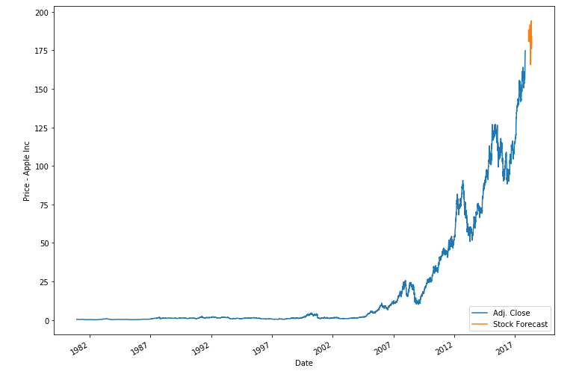
Stock prediction – apple inc
Apple Prediction Accuracy: 97.55%

Slide 12
Stock prediction - Lstm
Deep learning - Long Short-Term Memory (LSTM)
LSTMs are very powerful in sequence prediction problems because they’re able to store past information. This is important in our case because the previous price of a stock is crucial in predicting its future price

Slide 13
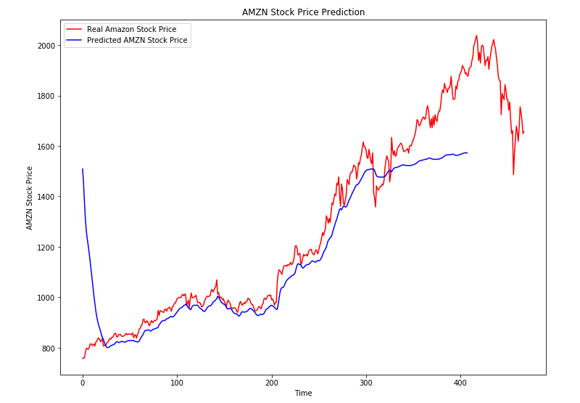
Lstm prediction - amazon

Slide 14
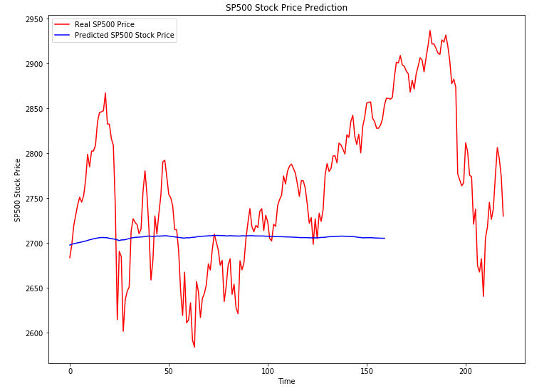
Lstm prediction – SP500
WTF

Slide 15
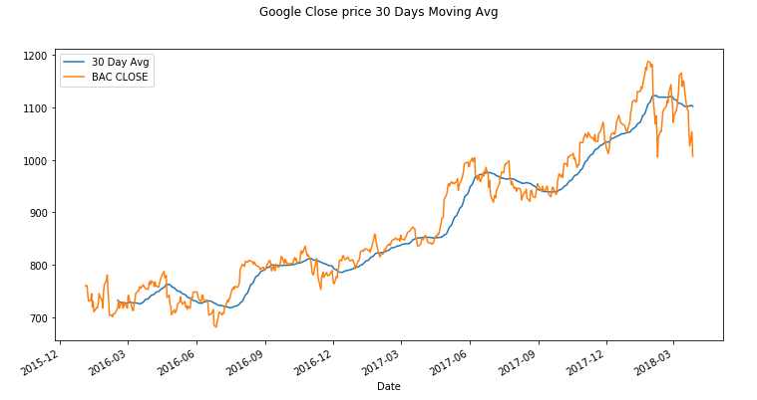
30Days Moving avg
Would a 30 Days Moving Ave Enough to predict a Trend?
Or Add as our Feature

Slide 16
Next step
LSTM better predictor?
Built another model
Add more features to the data, moving average, doncian channel, Bollinger
Instead of Predicting Future Price, we could predict Future Returns or Div Returns as a prediction

